Slide 1

IoT Fleet Management with balenaCloud

Slide 2
A Quick Tour

Slide 3
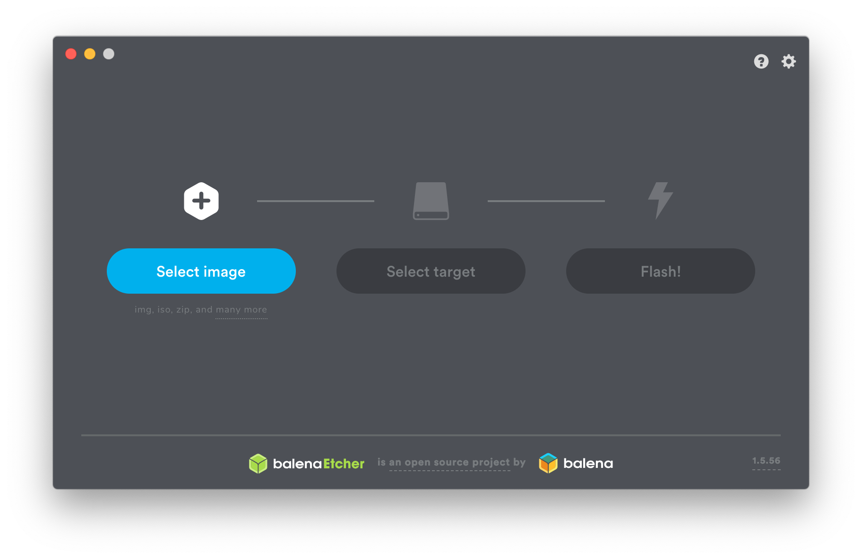
Notes:
I suspect there are some Etcher users in the audience.

Slide 4
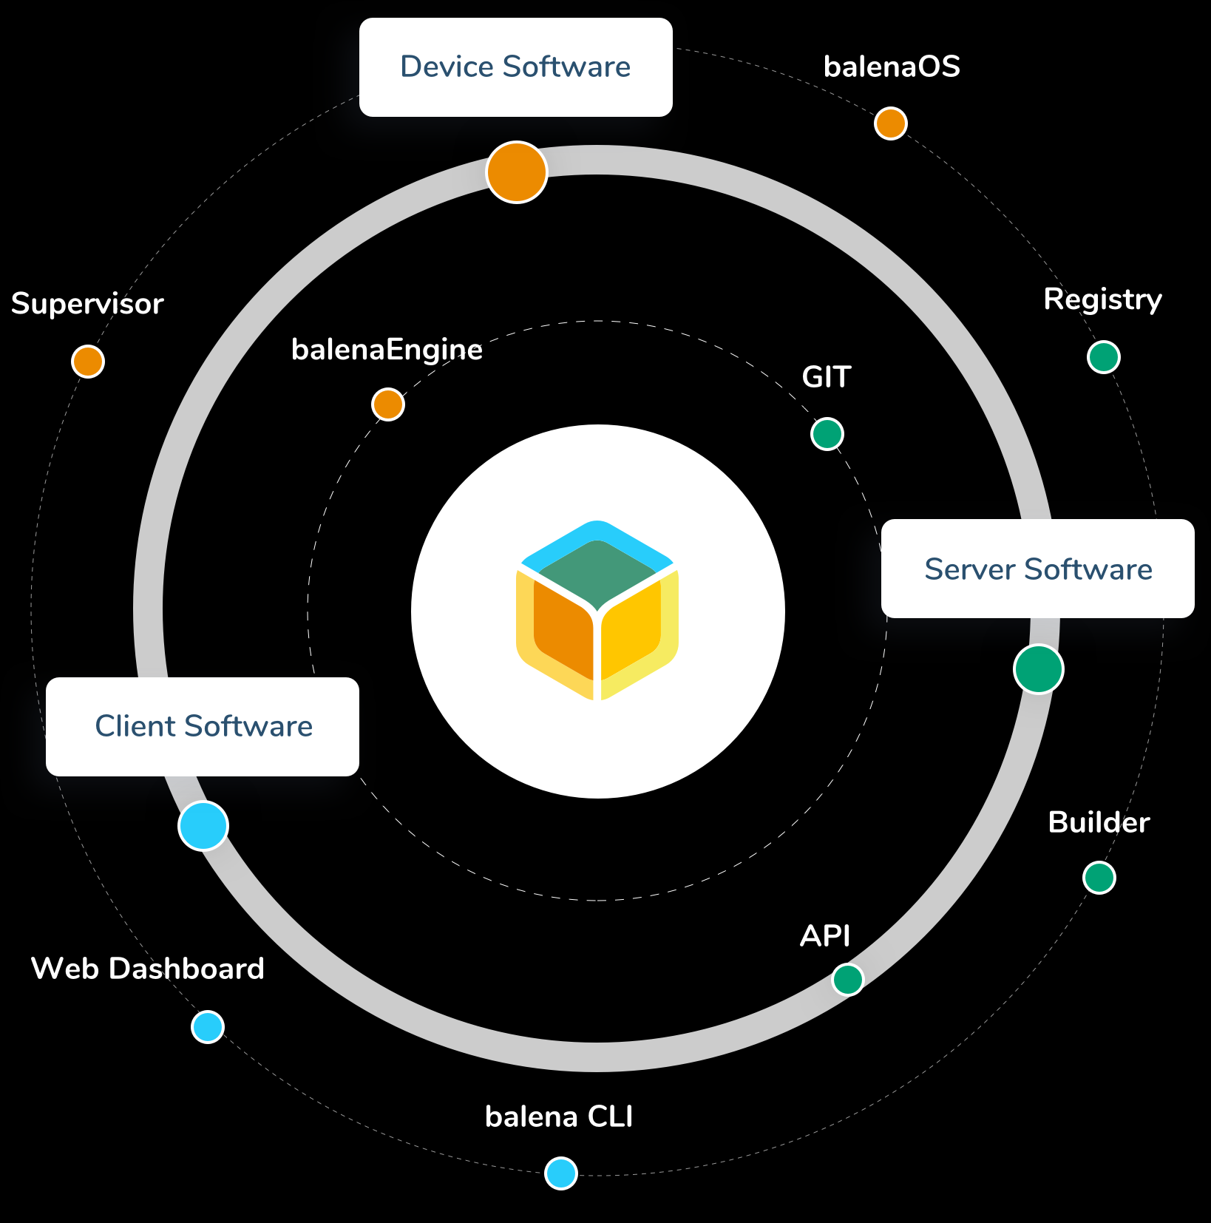
The Balena Ecosystem is Much More...
balenaCloud
balenaHub
balenaFin
EtcherPro
openBalena
balenaEngine
balenaOS
balenaLabs

Slide 5
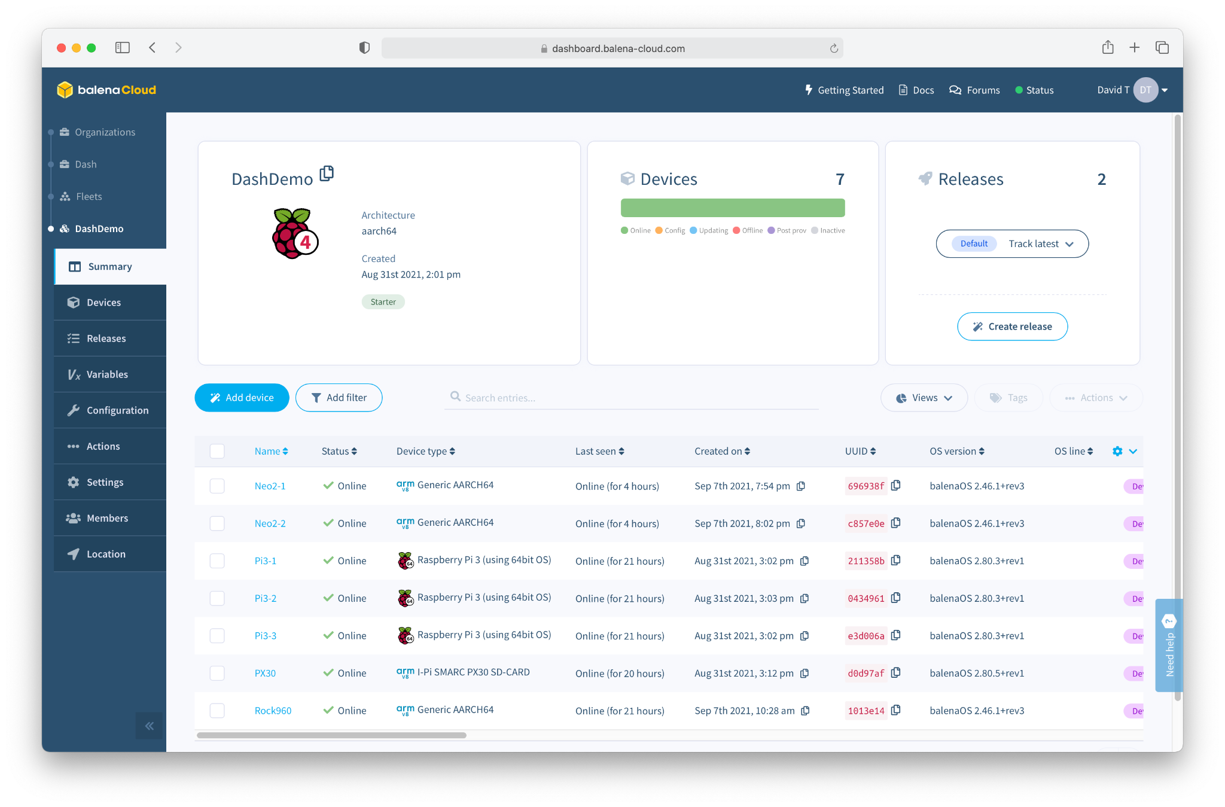
balenaCloud
“Platform built to develop, deploy, and manage fleets of connected devices at scale.”

Slide 6
What do we mean by IoT “Fleet Management”?

Slide 7
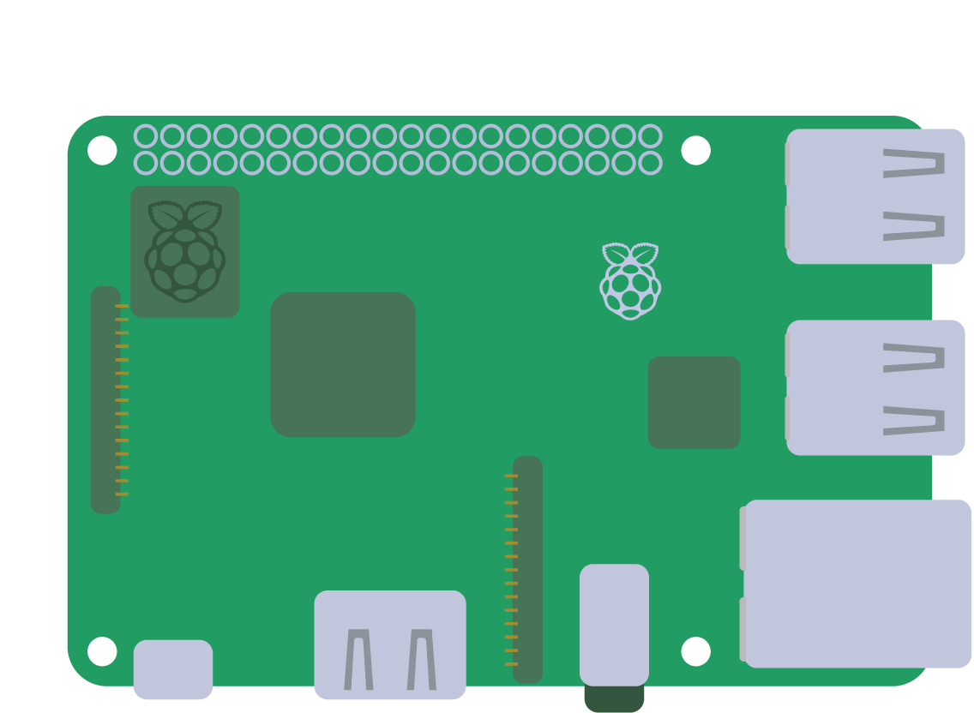


Slide 8
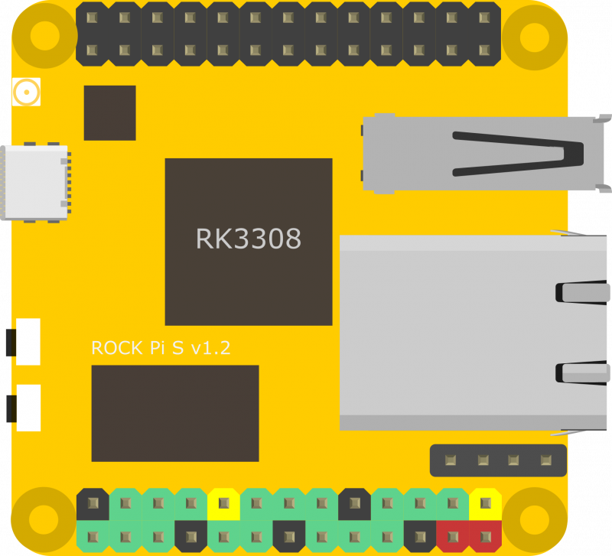
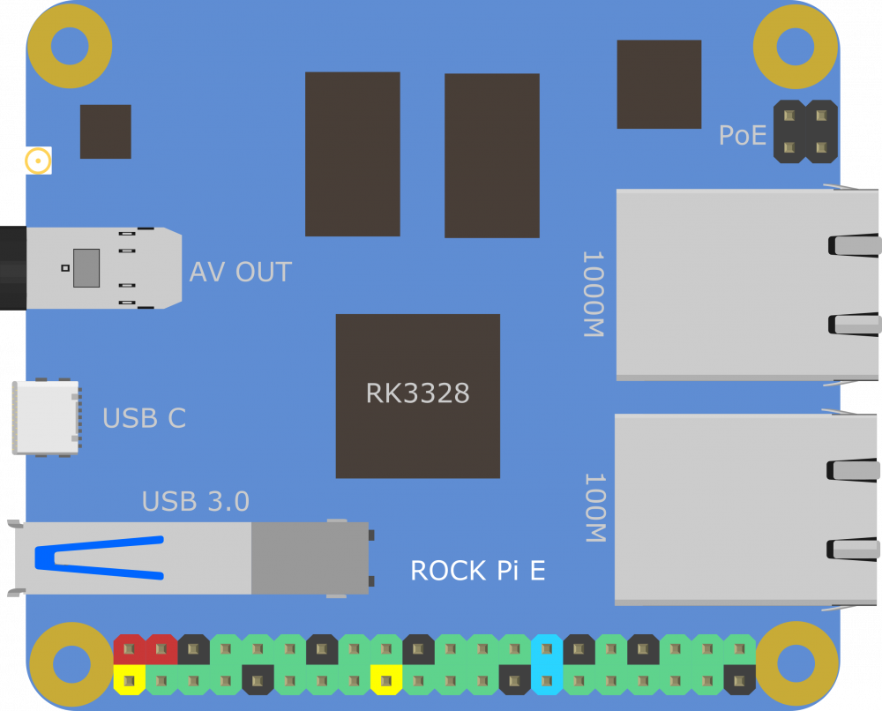
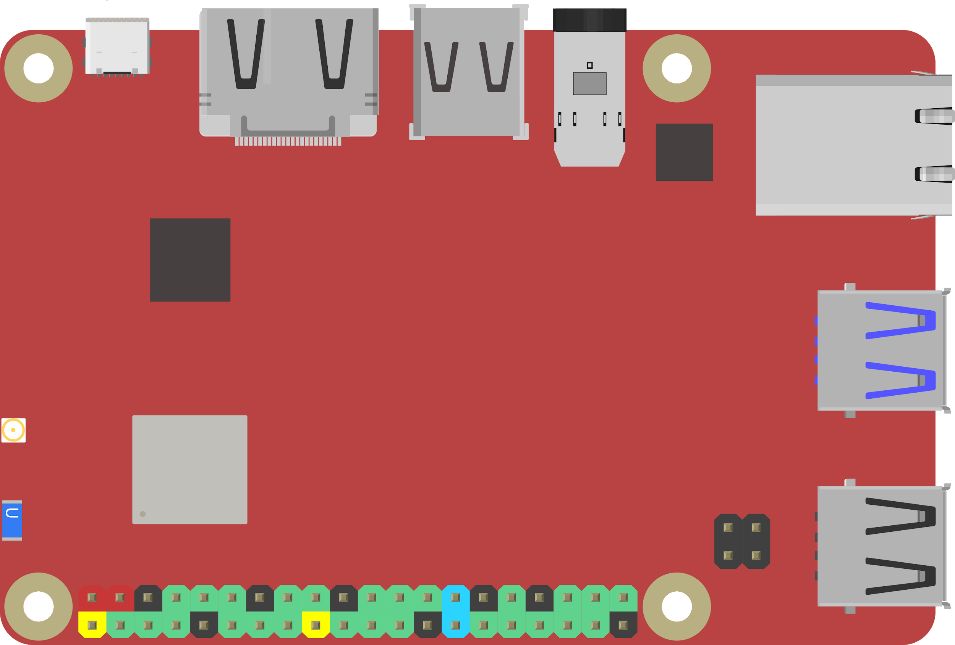
Notes:
48

Slide 10
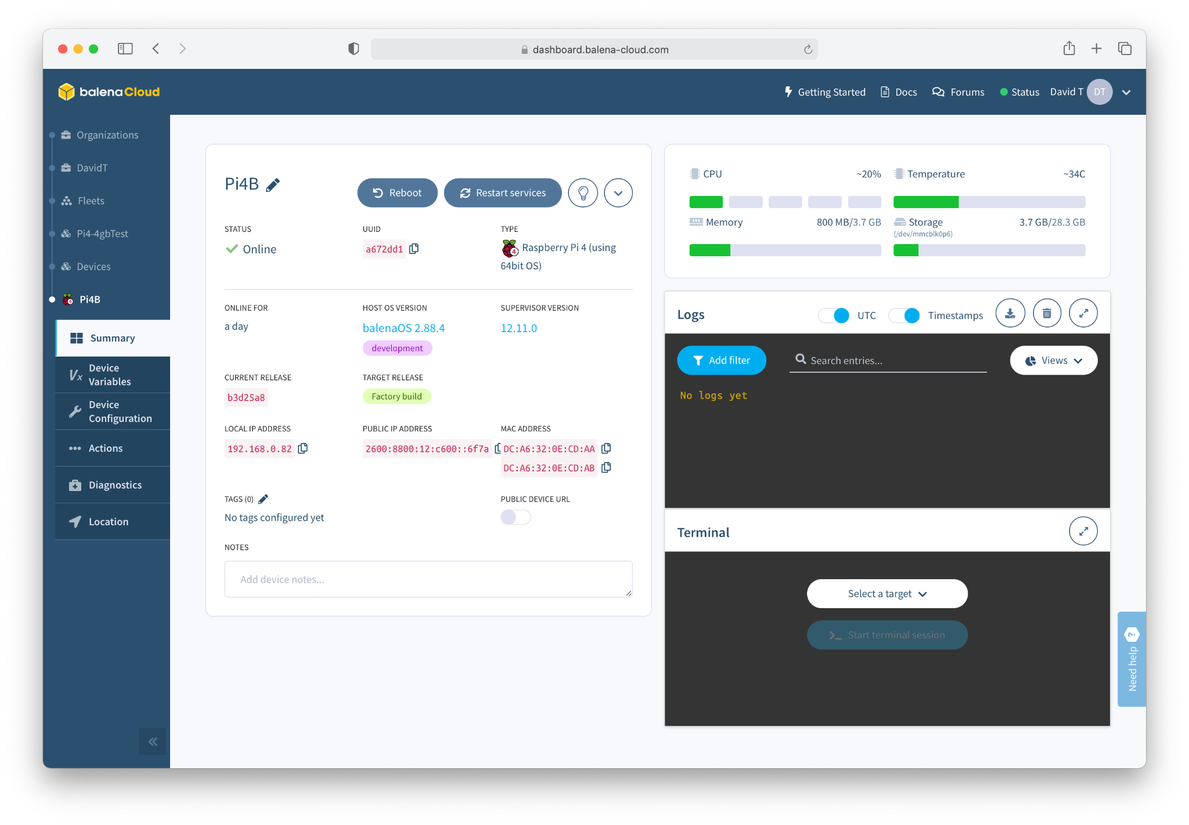

Slide 11
Deploying a Device is Easy

Slide 12
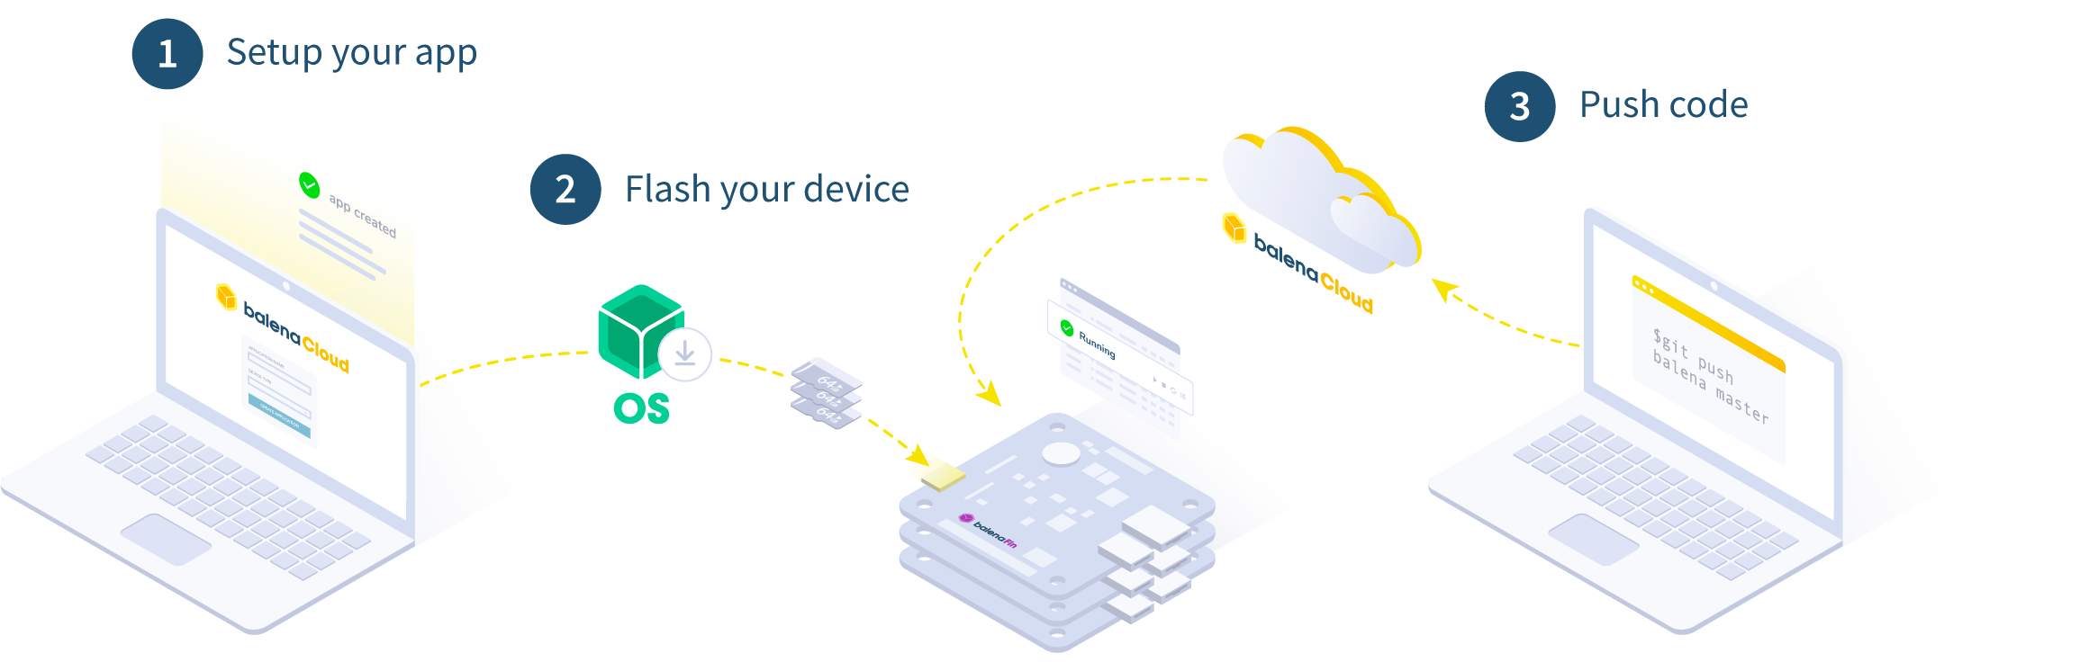
How it works

Slide 13
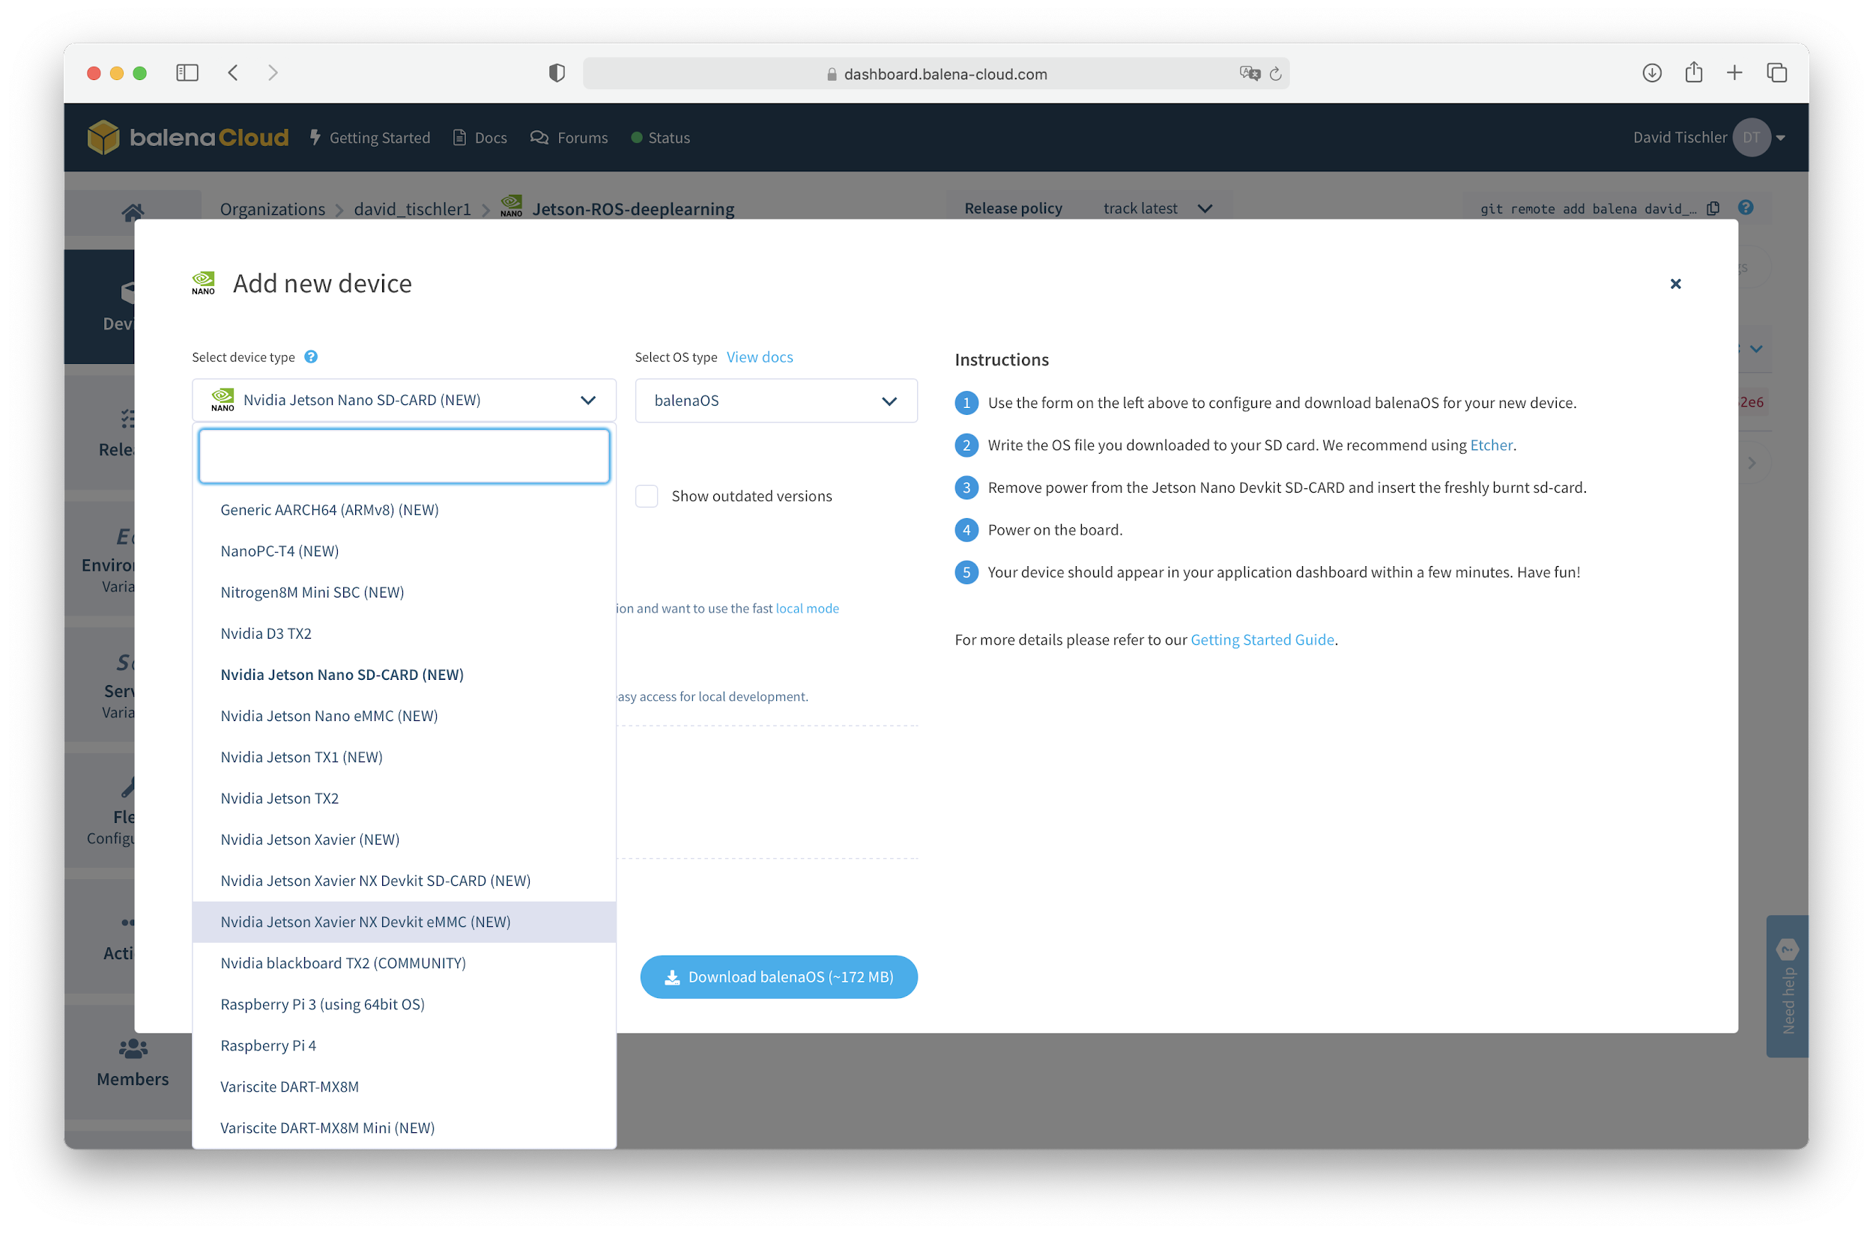

Slide 14
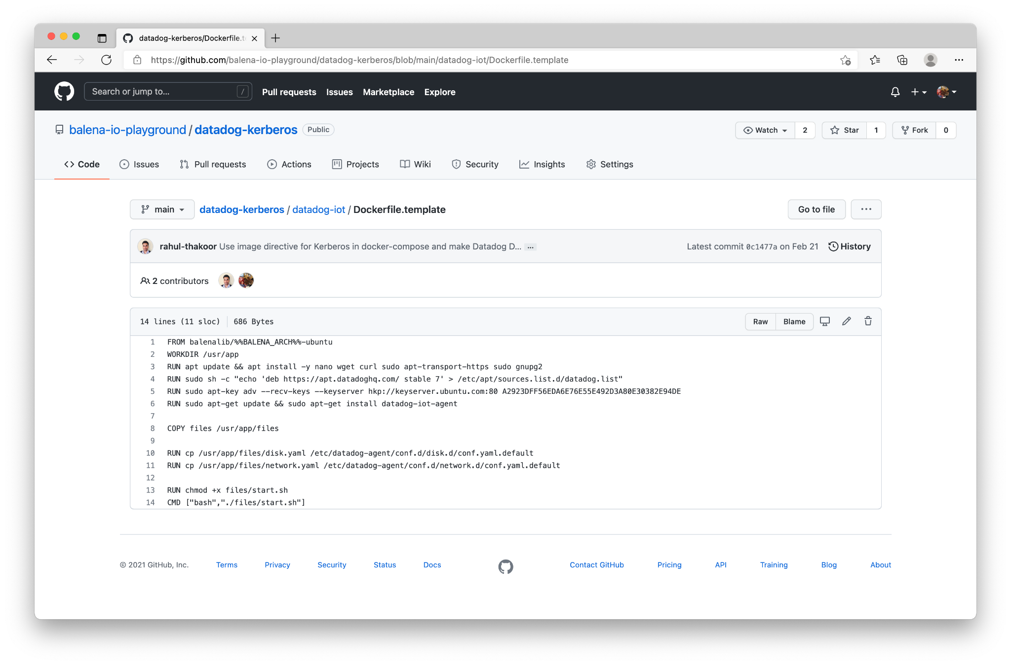

Slide 15
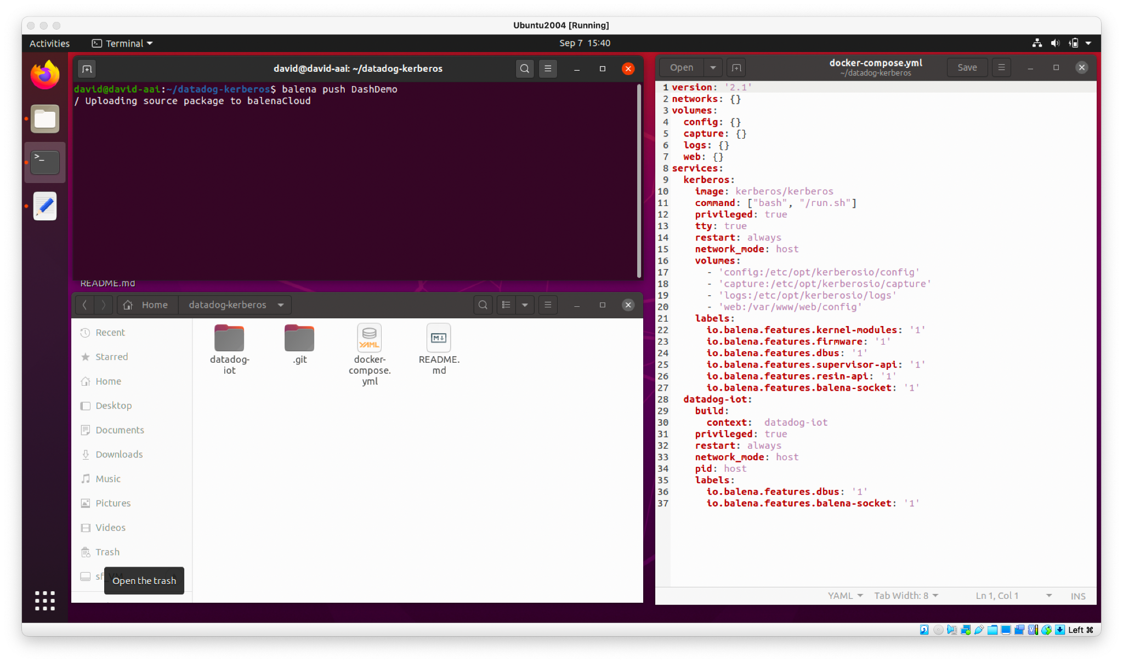
Build and Push Application to Fleet
Use balena CLI to package up application

Slide 16
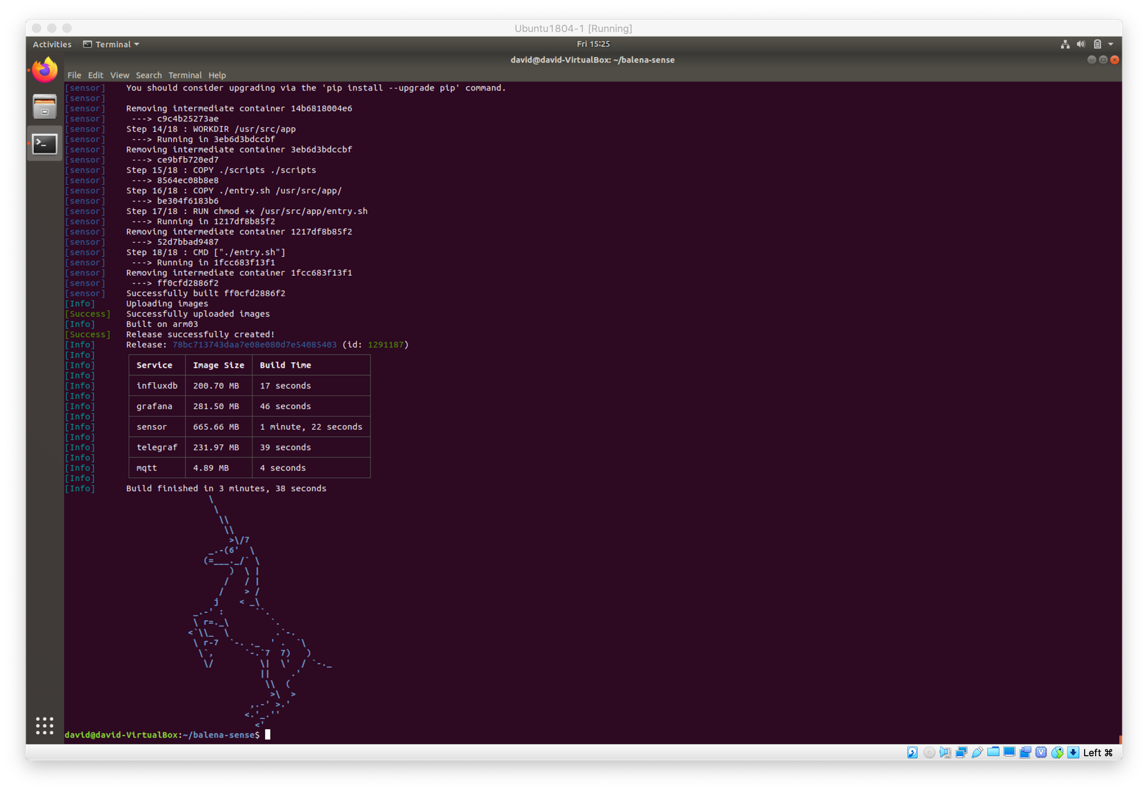
Build and Push Application to Fleet

Slide 17
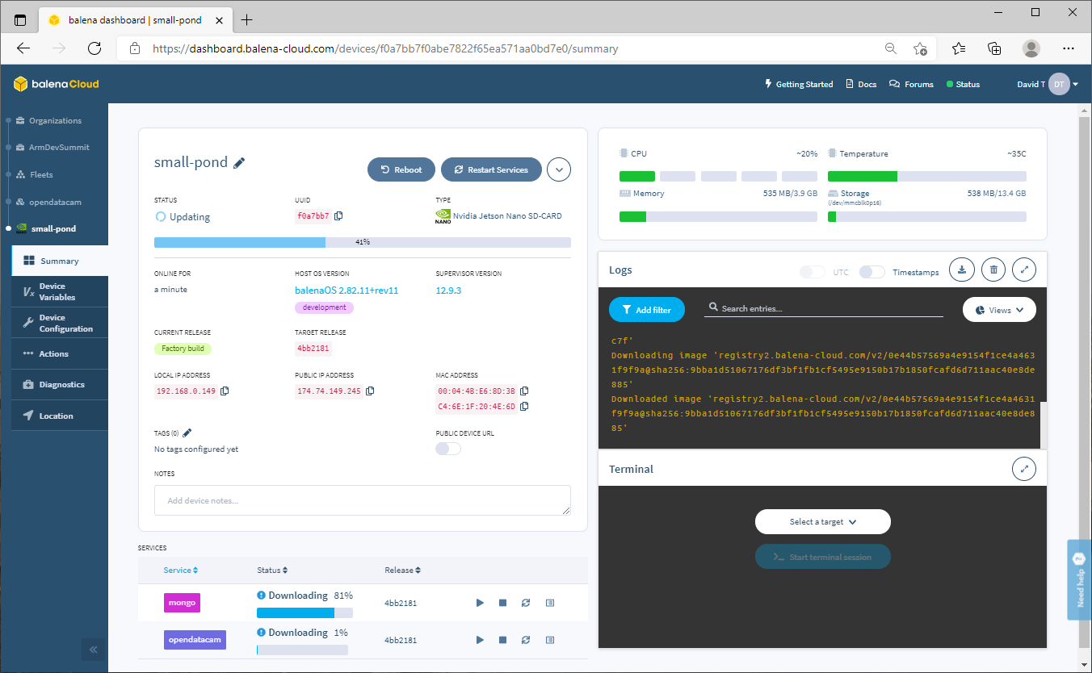

Slide 18
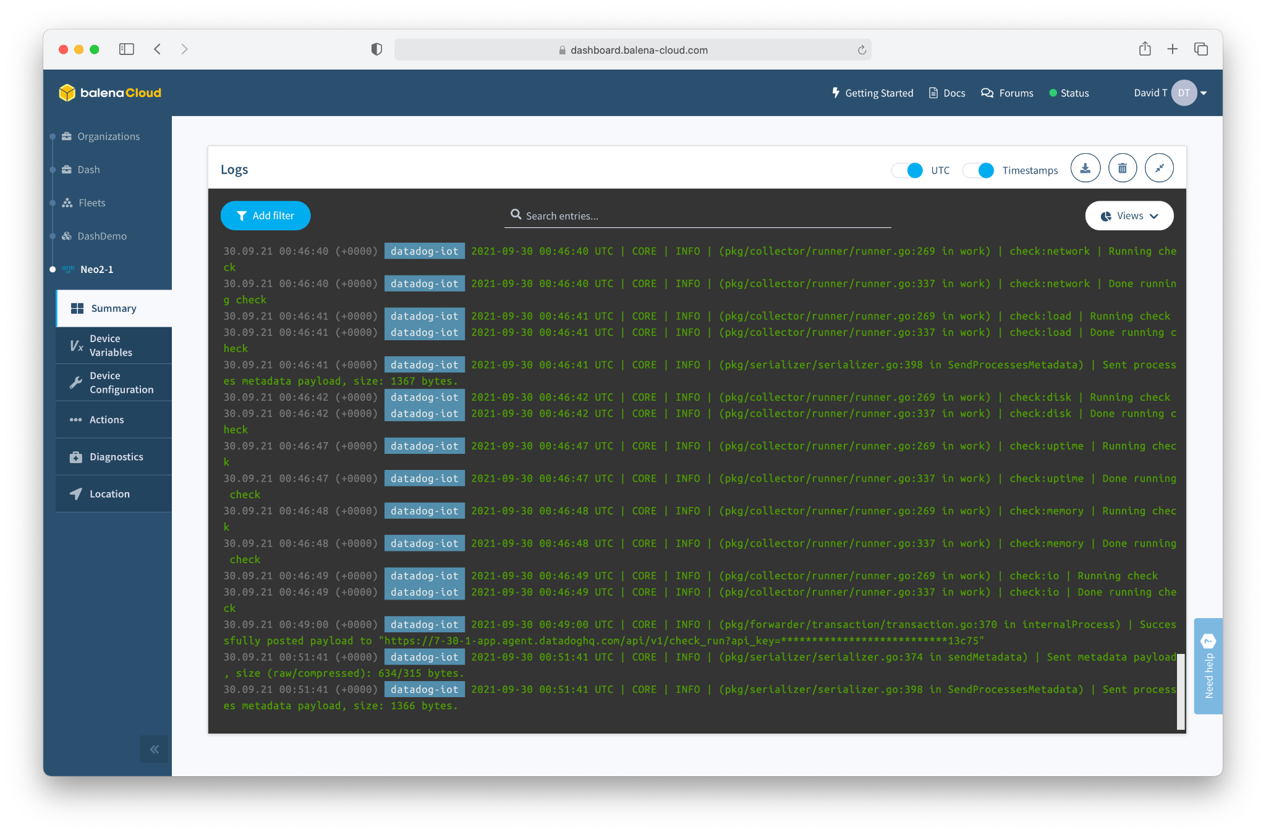

Slide 19
But How Do You Scale?

Slide 20
Let’s think about that workflow for a moment...
We built a container, and loaded it onto a device.
Containers can be updated. Changed. Added to. Improved.
We can push containers onto a device, over the air, no matter where it is located.
The Container(s) are your workload / application.
We deployed to one device. But, we could have deployed to 1,000 devices. Or 10,000.
Or 100,000.
We can manage and interact with the device from the web dashboard.

Slide 21
Let’s think about that workflow for a moment...
We can prototype on cheap / available hardware, but go to production with enterprise-grade hardware.
The container will run the same.
The devices show up in the dashboard.
You can push containers to entire Fleets at a time.

Slide 22
Some Best Practices

Slide 23
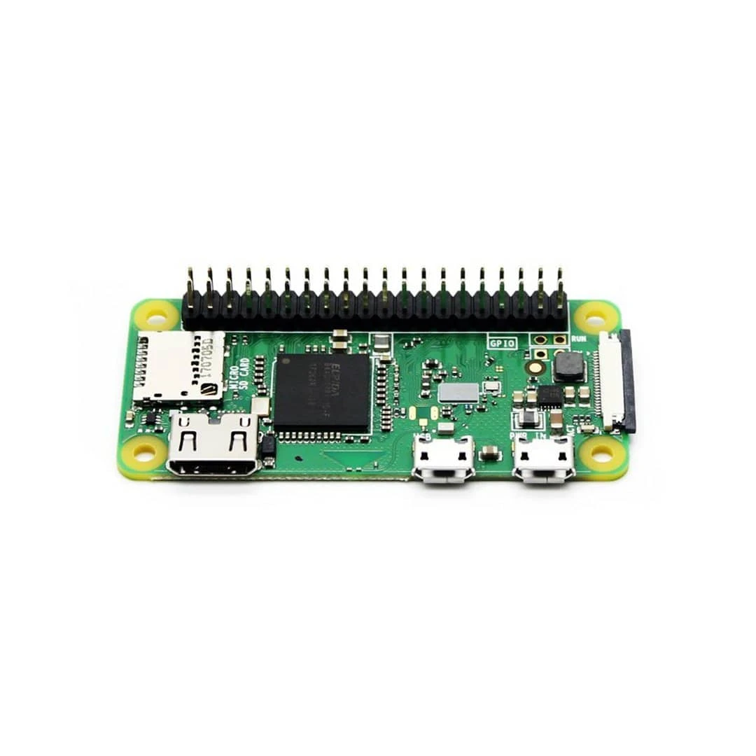
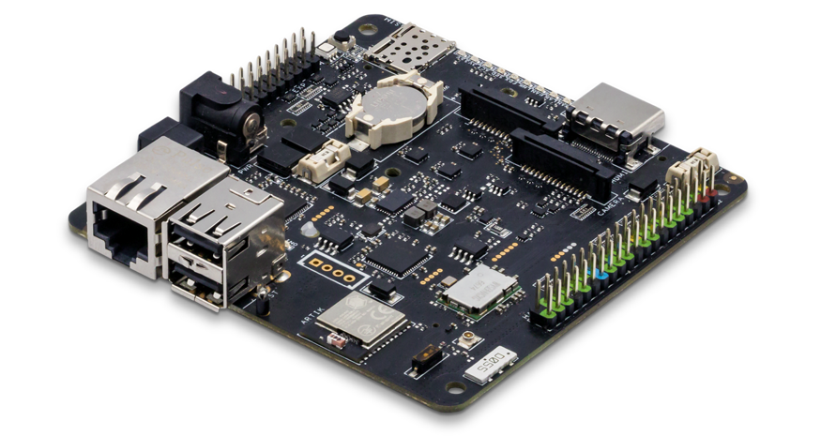
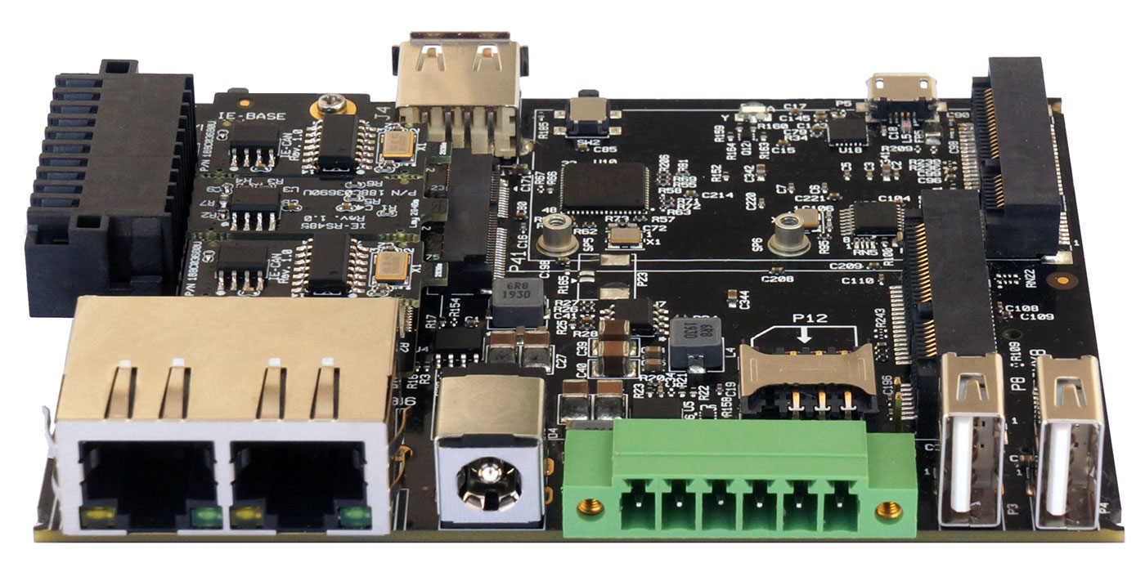
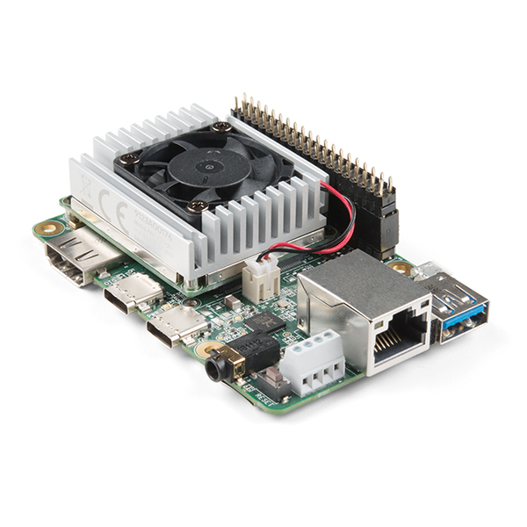
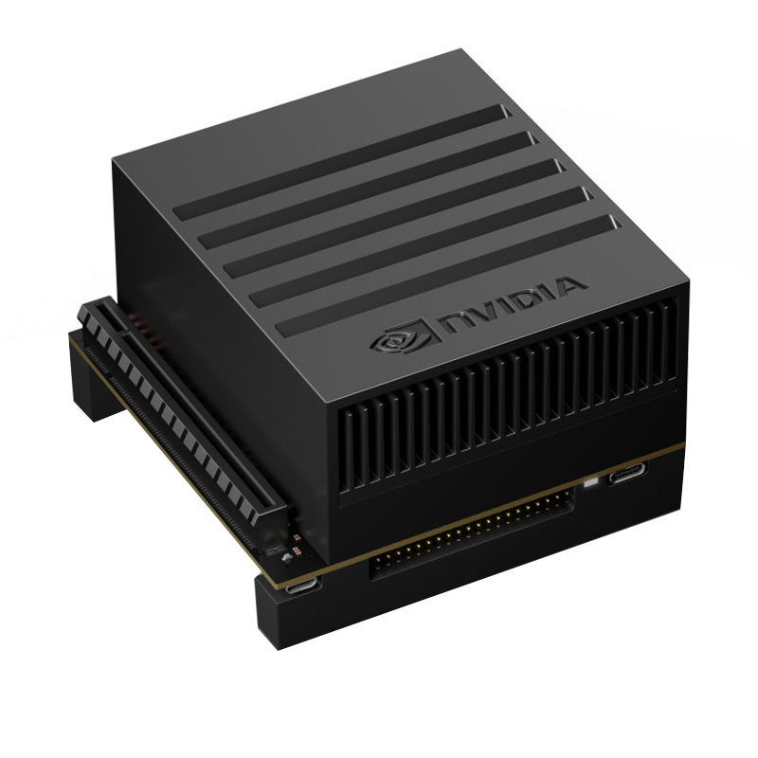
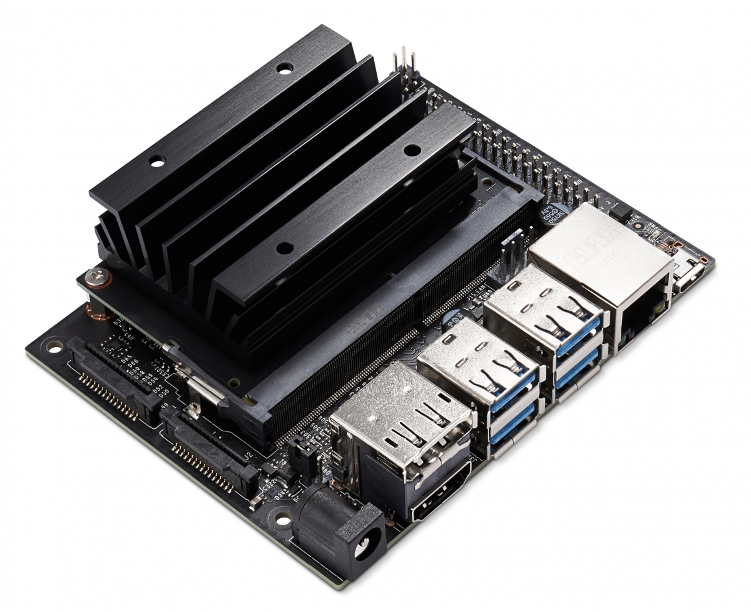
Hardware Selection
vs.
vs.
vs.
vs.

Slide 24
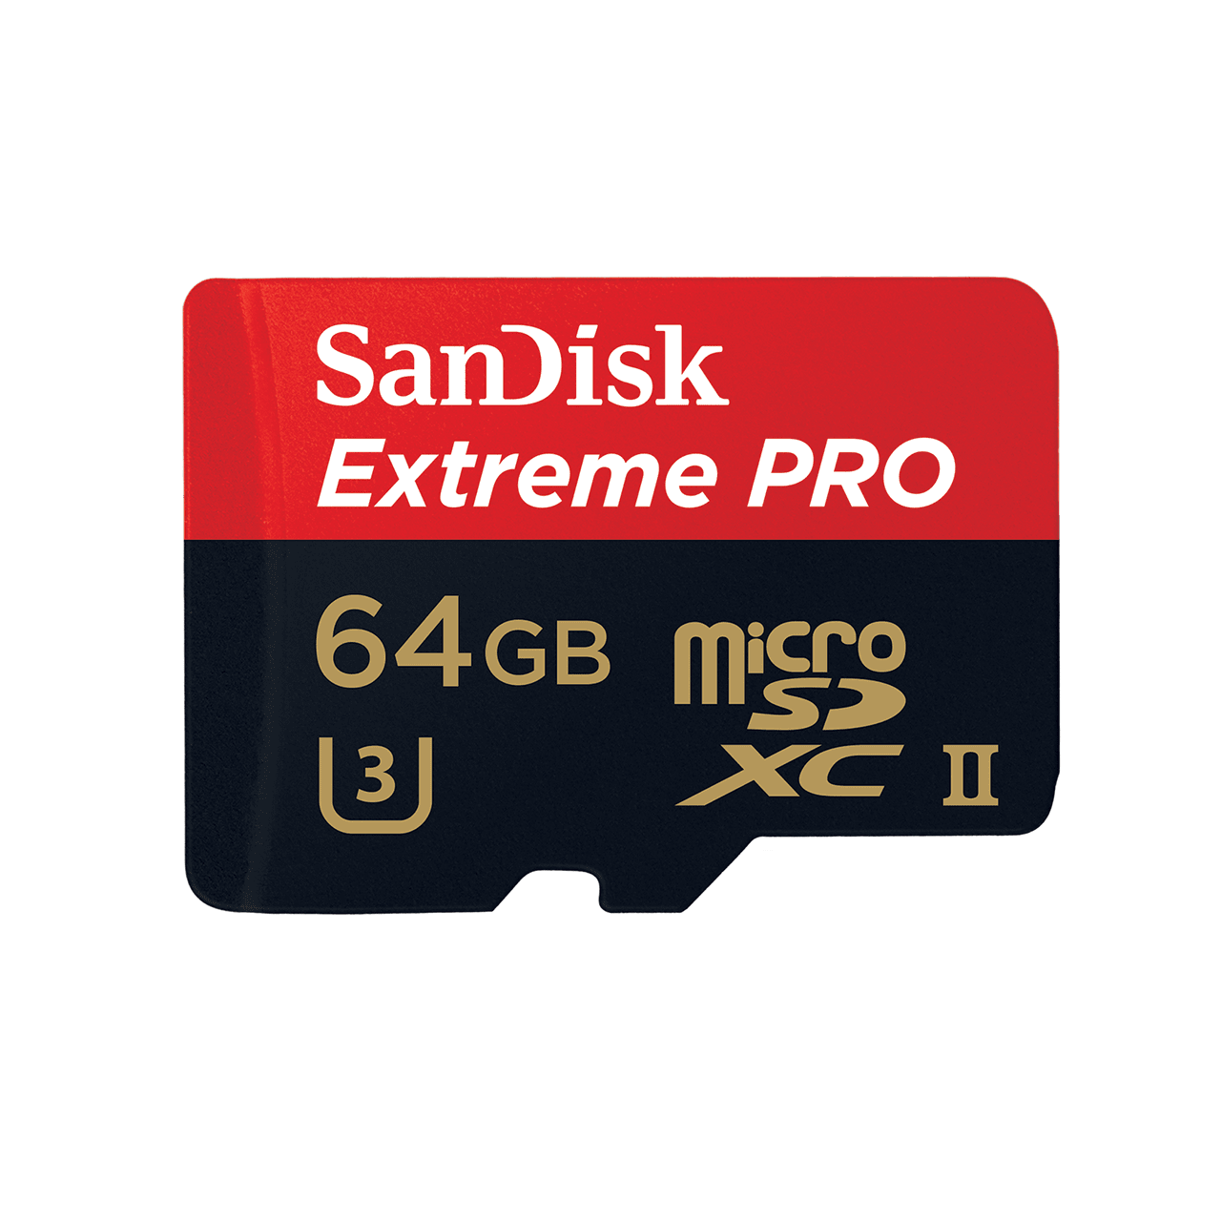

Slide 25



Slide 26
Things to try
http://hub.balena.io
http://balena.io/blog
http://github.com/balenalabs
Edge Impulse
Nvidia Jetson
ROS
Display, Signage, Kiosk
Environmental Sensing
OpenDataCam (Jetson Nano)
LoRa Gateways (TTN, Helium)
…. and more

Slide 27
Questions / Q&A

